Slide 1



Problem Statement (Title only)
Team Name and Team ID
<link to your unlisted YouTube video>
01

Slide 2

Flowchart
02
Please clearly state the step by step implementation of each stage of the solution.

Slide 3
Use Case and Real-Life Impact
03
Please cover the following points:
What is your target audience, how will they use your solution and why?
Clearly state scenarios where the features of your solution will be implemented.
What impact will the solution have on the target demographic?

Slide 4
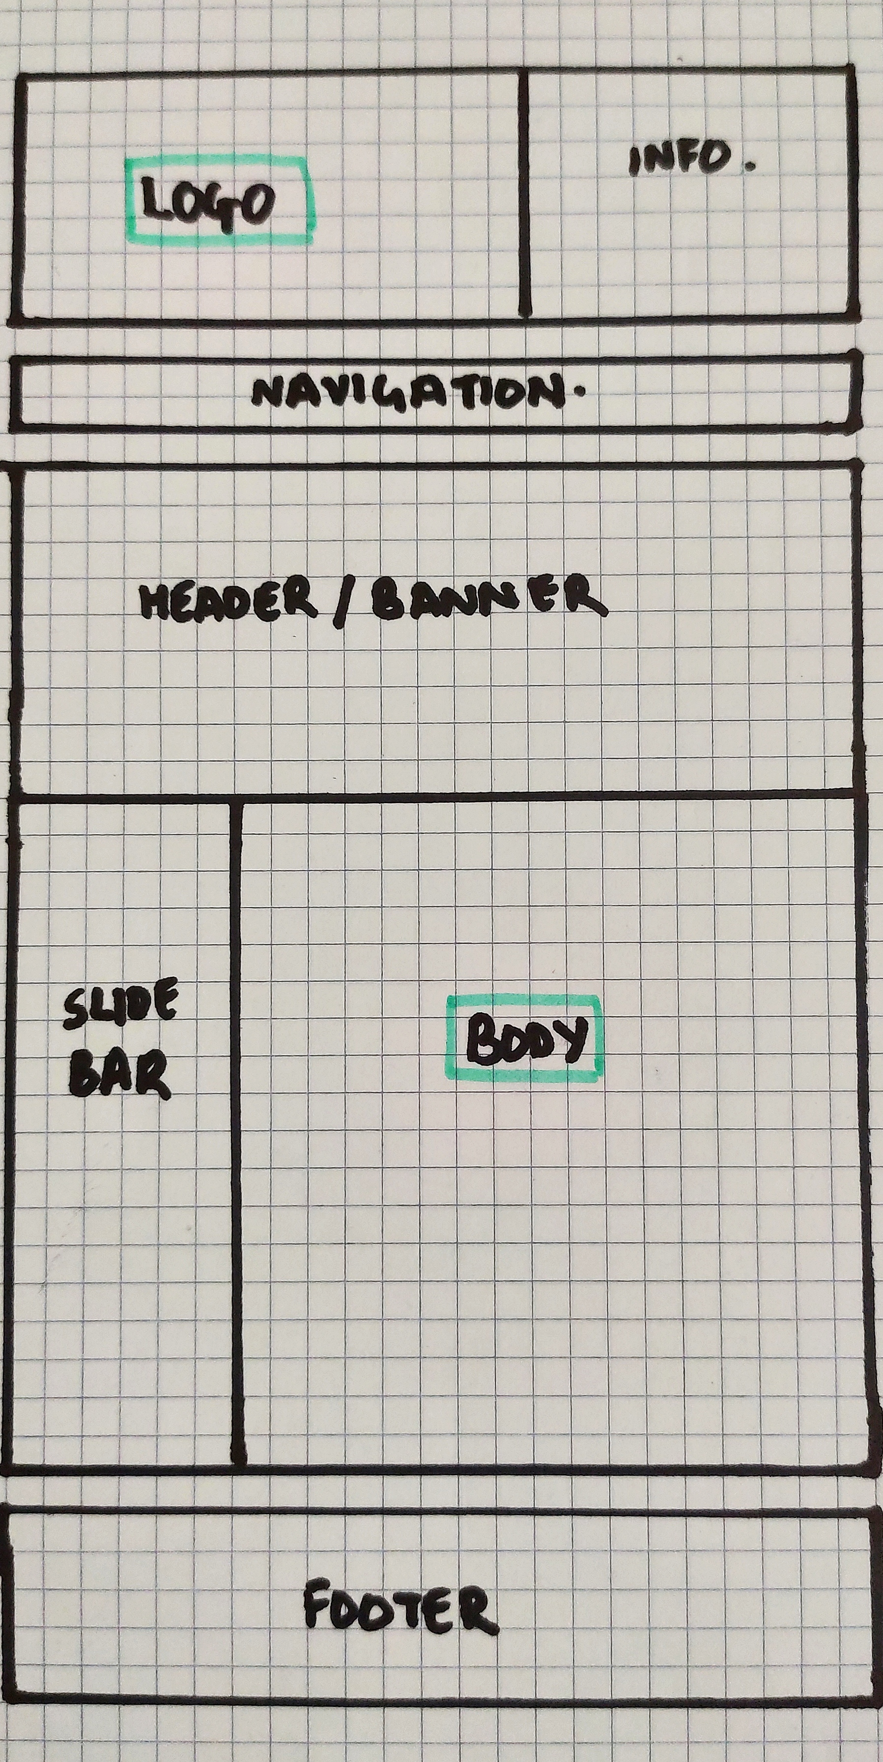
UI/UX Frames
04
Refer to the sample shown to the left.
Please include a hand-drawn design of web-pages/app-pages. Alternatively, you can include the wireframes.
Please include UI frames/ UX designs of your solution keeping in mind how user-friendly your UI/UX is.
You could refer to software such as Balsamiq and Wireframes.cc, for the same.

Slide 5
Features of the Application
05
List the features of your solution and briefly explain its implementation.

Slide 6
[OPTIONAL] Additional Features
[06]
You may include any two additional features which were not mentioned previously in your abstract.

Slide 7
Algorithms Used
06
Please include an explanation of the algorithm you plan to use in your solution (if any).
Clearly state where it will be implemented in your solution and to solve which problem.

Slide 8
Technologies used
07
List all technologies you plan on using for your solution. Please include:
Type of software (Web or Mobile Application) you plan to use.
Software/Hardware dependencies.
Design Constraints.
Technology Stack & Frameworks you will be using (Include any APIs you plan to use).
Development Platforms you may use in your solution.
Specify If you plan to reuse of existing software components or libraries.
Mention any licensing/subscription cost incurred for utilizing third party services.

Slide 9
Technologies used
08
You may continue with your list here.

Slide 10
Novelty
09
Please address the following questions here:
How unique is your solution and what makes your solution stand out? How is your solution different from any existing solutions?
What change can your solution bring?

Slide 11
References
10
Please include a minimum of five credible sources as references.

Slide 12

THANK YOU
Team Name and Number
11

